Slide 1
Sun trap
The Sun is a star in the centre of the Solar System.
The Sun is as big as a million planets the size of Earth.
Not to scale

Slide 2
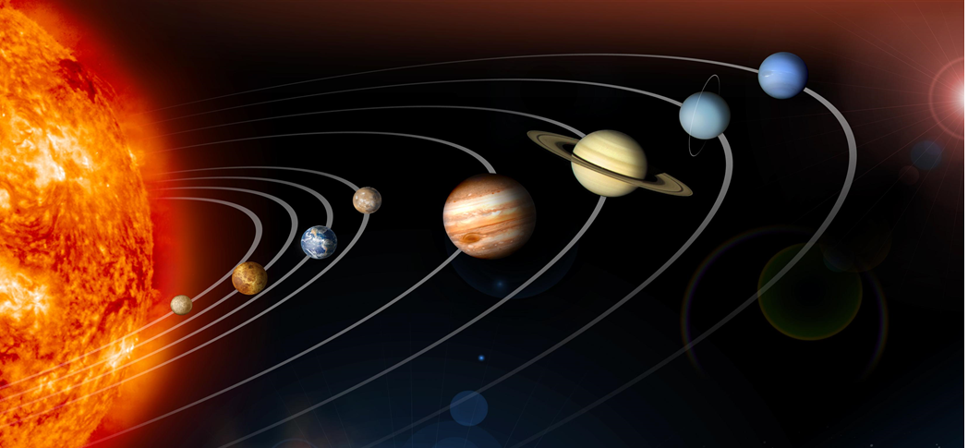
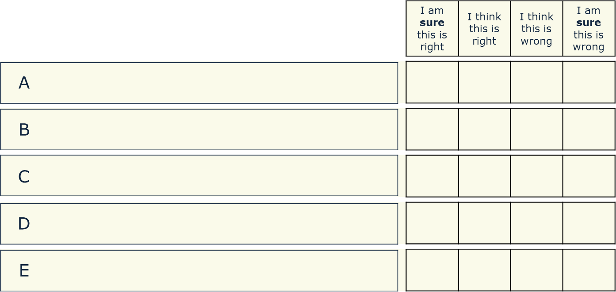
Sun trap
What do you think about the Sun’s gravity?
The Sun has no gravity because it has no air
The Sun has a very big gravity because it has a huge mass
The Sun’s gravity reaches out deep into space
The Sun’s gravity pulls all the planets towards it
The Sun’s gravity stops the planets shooting off into space

